Slide 1
Linear Regression and Gradient Descent

Slide 2
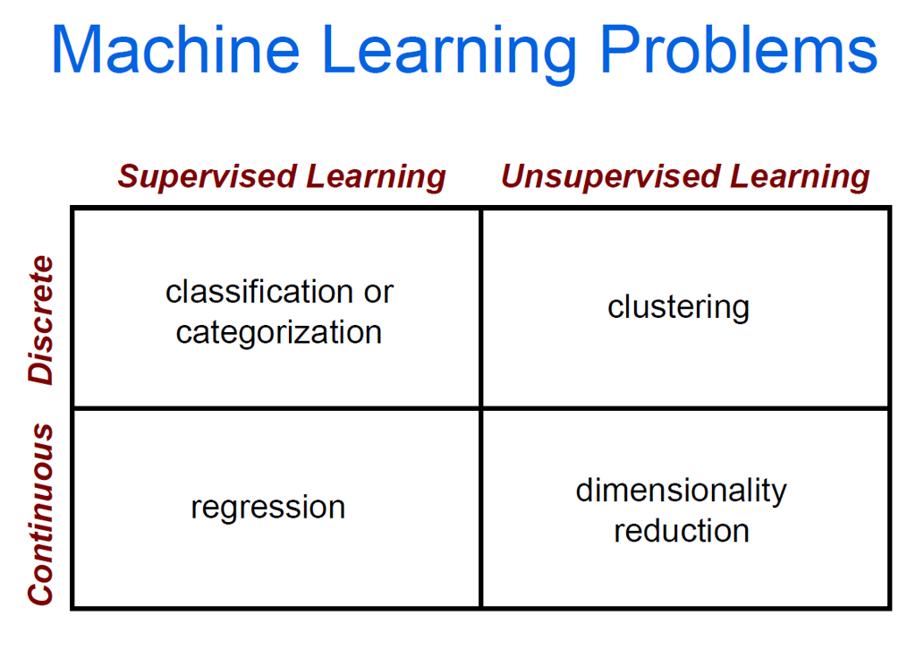
Where are we at?

Slide 3
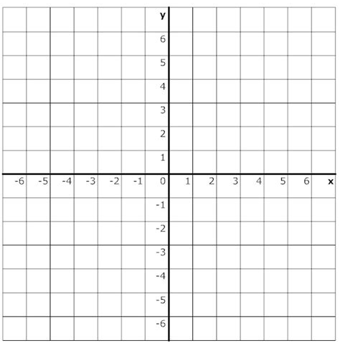
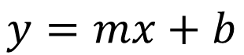
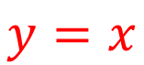
Linear equation
$$y=x$$
$$y=mx+b$$
slope
intercept

Slide 4
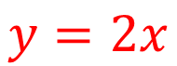
Linear equation
$$y=2x$$
$$y=mx+b$$
slope
intercept

Slide 5
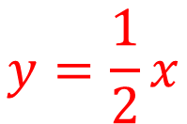
Linear equation
$$y=\frac{1}{2}x$$
$$y=mx+b$$
slope
intercept

Slide 6
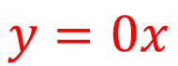
Linear equation
$$y=0x$$
$$y=mx+b$$
slope
intercept

Slide 7
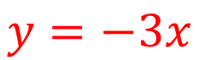
Linear equation
$$y=−3x$$
$$y=mx+b$$
slope
intercept

Slide 8
Linear equation
$$y=x$$
$$y=mx+b$$
slope
intercept

Slide 9
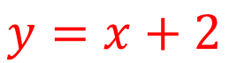
Linear equation
$$y=x+2$$
$$y=mx+b$$
slope
intercept

Slide 10
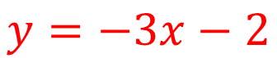
Linear equation
$$y=−3x−2$$
$$y=mx+b$$
slope
intercept

Slide 11
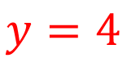
Linear equation
$$y=4$$
$$y=mx+b$$
slope
intercept

Slide 12
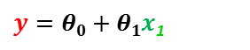
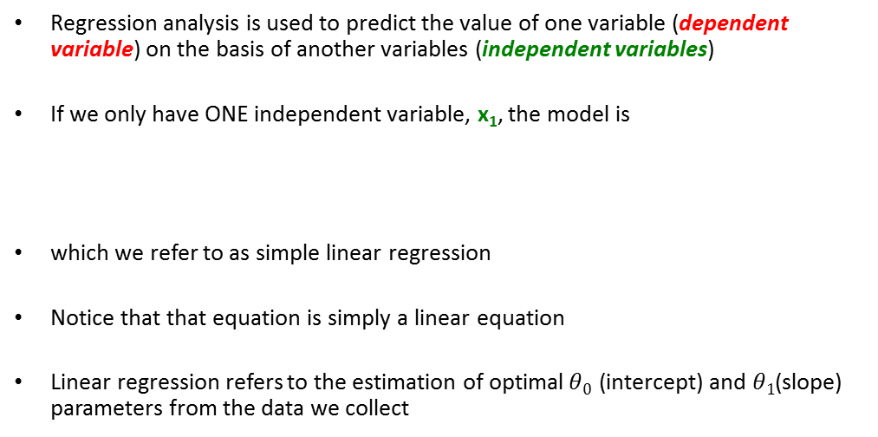
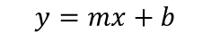
Linear Regression uses a linear equation to model data
Regression analysis is used to predict the value of one variable (dependent variable) on the basis of another variables (independent variables)
If we only have ONE independent variable, x₁, the model is
which we refer to as simple linear regression
Notice that that equation is simply a linear equation
Linear regression refers to the estimation of optimal$θ0$ (intercept) and $θ1$(slope) parameters from the data we collect
$y=θ0+θ1x$₁
$$y=mx+b$$

Slide 13

Using the linear equation to model data
Question: can we find a linear equation that allows us to determine the value of the dependent variable (Height) from the value of the independent variable (Weight)?
$$y=θ0+θ1x$$
Height
Weight

Slide 14
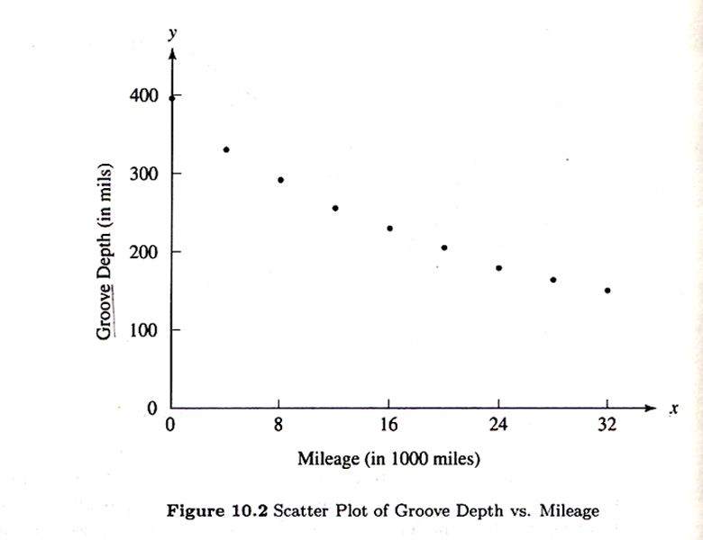

Using the linear equation to model data
Question: can we find a linear equation that allow us to determine the value of the Tire Wear (Groove Depth) from the value of the independent variable (Mileage)?
$$y=θ0+θ1x$$

Slide 15
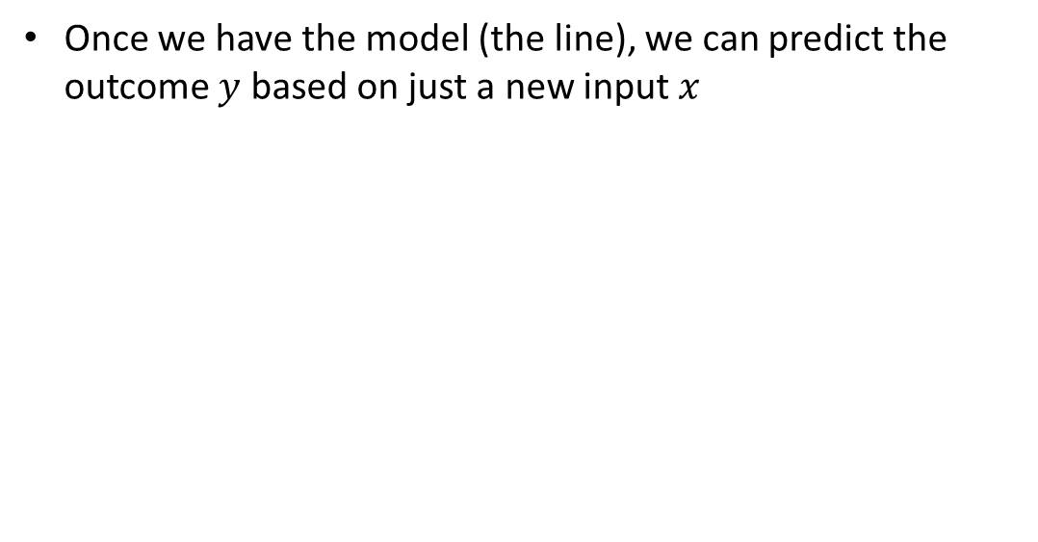
Why is it important to get a model?
Once we have the model (the line), we can predict the outcome $y$ based on just a new input $x$
Y
X
Notes:
Although none of us can know the future, predicting it is so important that organisms are hard-wired to learn about predictable events in their environment
In fact, the construct “intelligence” is just a way of measuring the ability of an organism to predict the future in one or several domains
A useful prediction of intelligence to interpret this definition is that intelligence is just the ability to detect patterns in the environment
There is a hierarchy of patterns in the world going from very simple to very complex
Higher intelligence is required to notice ( i.e. detect) complex patterns
Regression offers the ability to “predict” the future days on pass data
This makes the huge ( and often incorrect) assumption, the future will behave similarly to the past
Notice that regression will only work if future behavior of the system resembles past behavior of the system
This is not always the case in complex systems
Otherwise we could predict the behavior of the stock market
So linear regression is a way of predicting an outcome variable (Y) from one or a set of predictor variables (X)

Slide 16
Housing Prices
Price
(in 1000s of dollars)
Size (feet²)
Regression Problem: predict the price (real value output) of a house based on its size in square feet

Slide 17
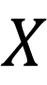
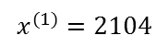
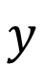
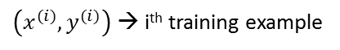
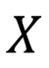
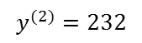
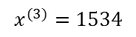
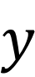
$$X$$
$$y$$
Training set of
housing prices
$$X$$
$$y$$
Size in feet² (x) | Price ($) in 1000's (y)
2104 | 460
1416 | 232
1534 | 315
852 | 178
… | …
Notation:
x’s = “input” variable / features
y’s = “output” variable / “target” variable
$\left(x^{(i)},y^{(i)}\right)$ → i^{th} training example
$$x^{(1)}=2104$$
$$x^{(3)}=1534$$
$$y^{(2)}=232$$

Slide 18
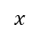
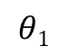
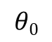
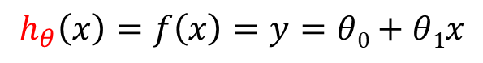
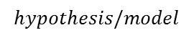
y
Training Set
$$θ1$$
$$θ0$$
1
Linear regression
1
x
$$h_{θ}\left(x\right)=f\left(x\right)=y=θ0+θ1x$$
Size of house
h
Estimated price
intercept
slope
$$x$$
$$hypothesis/model$$
y
h is basically a map (a function, f, ) from x to y

Slide 19
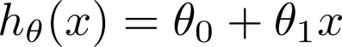
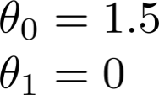
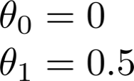
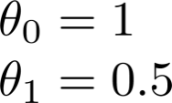
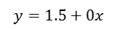
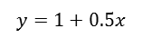
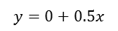
Some exemplary hypothesis
$$y=1+0.5x$$
$$y=1.5+0x$$
$$y=0+0.5x$$

Slide 20
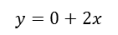
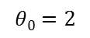
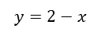
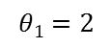
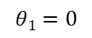
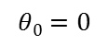
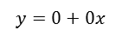
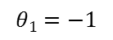
Some exemplary hypothesis
$$y=2−x$$
$$y=0+2x$$
$$y=0+0x$$
$$θ0=2$$
$$θ0=0$$
$$θ0=0$$
$$θ1=−1$$
$$θ1=2$$
$$θ1=0$$

Slide 21

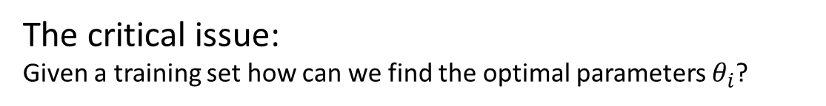
The critical issue:
Given a training set how can we find the optimal parameters $θ_{i}$?
Training Set
Size in feet² (x) | Price ($) in 1000's (y)
2104 | 460
1416 | 232
1534 | 315
852 | 178
… | …
Hypothesis:

Slide 22
Which line has the best fit to the data?
Minimize the distance between the points and the hypothesis line
The method of least squares produces a straight line that minimizes the sum of the squared differences between the points and the line
y
y
y
x
x
x

Slide 23
Which line has the best fit to the data?
Plots of the data points (crosses in red), and several model lines (in blue), with the residuals shown in green
y
y
y
x
x
x

Slide 24
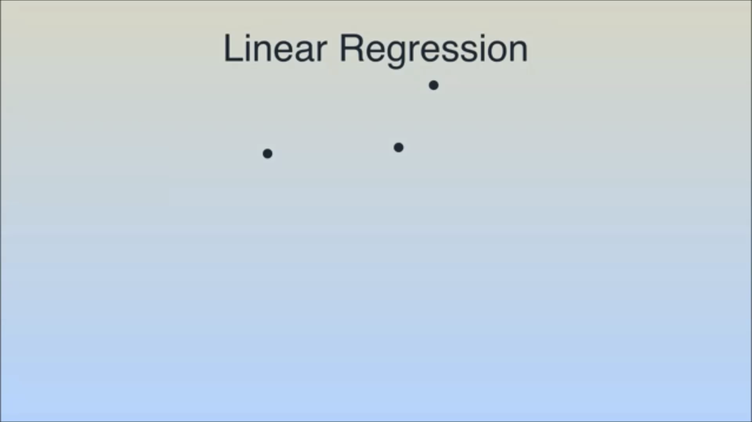

Slide 25

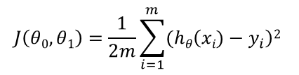
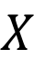
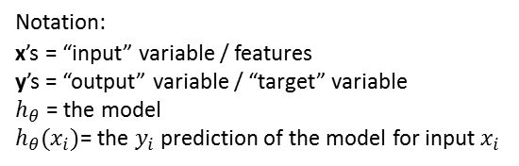
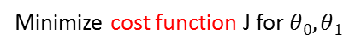

Mathematical formalization of how to choose the optimal parameters to get a least squares line Least Squares fitting
$$X$$
$$y$$
$$hθ(x)=θ0+θ1x$$
y
Minimize cost function J for $θ0,θ1$
$$J\left(θ0,θ1\right)=\frac{1}{2m}\sum_{i=1}^{m}{(hθ\left(xi)−y_{i}\right)2 }$$
x
Intuition: choose $θ_{0},θ_{1}$so that $h_{θ}\left(x\right)$ is close to our training examples $(x,y)$
Notation:
x’s = “input” variable / features
y’s = “output” variable / “target” variable
$h_{θ}$ = the model
$h_{θ}(x_{i})$= the $y_{i}$prediction of the model for input $x_{i}$

Slide 26









Cost/Loss/Error function $J\left(θ_{n}\right)$intuition
Simplified
Hypothesis:
Parameters:
Cost Function:
Goal:

Slide 27









(for fixed , this is a function of x)
(function of the parameter )
y
$$hθ\left(x\right)=0x$$
x
$$θ1=0$$
$$J\left(θ1\right)=\frac{1}{2m}\sum_{i=1}^{m}{\left(θ1x^{(i)}−y^{(i)}\right)2=2.3}$$

Slide 28





(for fixed , this is a function of x)
(function of the parameter )
y
$$hθ\left(x\right)=0.5x$$
x
$$θ1=0.5$$
$$J\left(θ1\right)=\frac{1}{2m}\sum_{i=1}^{m}{\left(θ1x^{(i)}−y^{(i)}\right)2=\frac{1}{2m}\left((0.5−1)2+(1−2)2+(1.5−3)2\right)=0.58}$$

Slide 29



(for fixed , this is a function of x)
(function of the parameter )
$$hθ\left(x\right)=θ1x=x$$
y
x
$$θ1=1$$
$$J\left(θ1\right)=\frac{1}{2m}\sum_{i=1}^{m}{\left(hθ\left(x^{(i)}\right)−y^{(i)}\right)2=\frac{1}{2m}\sum_{i=1}^{m}{\left(θ1x^{(i)}−y^{(i)}\right)2=\frac{1}{2m}\left(02+02+02\right)=0}}$$

Slide 30








$$θ1=2$$
$$θ1=1.5$$
(function of the parameter )
$$θ1=1$$
y
$$θ1=0.5$$
$$θ1=0$$
x
$$θ1=1 minimizes J\left(θ1\right)$$
Optimal model: $θ_{1}=1 → hθ\left(x\right)=x$

Slide 31






Cost function with 2 variables
Hypothesis:
Parameters:
Cost Function:
Goal:

Slide 32

Moment to pause and reflect
The example shown is extremely simple
You can estimate the optimal parameters just looking at the data
You don’t need computers for that
However, as you increase the number of parameters to optimize, your ability to visually determine the optimal parameters extinguishes
Furthermore, for most practical problems neither you nor the computer knows the shape of $J(θ)$
That’s why you need computational approaches for optimization

Slide 33







Key question: How do you decide which values of $θ0$and $θ1$you try next in order to arrive soon into an optimal value of $J?$
Problem: Neither you nor the computer know the shape of $J\left(θ0,θ1\right)$
Probing the entire parameter space is computationally unfeasible for problems with large numbers of parameters
$$J$$
$$J$$
$$θ0$$
$$θ0$$
$$θ1$$
$$θ1$$

Slide 34


2 main categories of solutions strategies to find the optimal parameters $θ_{n}$for machine learning problems
Analytical/Closed form solution (mathematical formula): super elegant but the solution is not always known
Iterative solution (iterative algorithm): computationally heavy but solution will always be found (assuming enough computational resources are available)
Gradient descent

Slide 35


Intuition about finding the minimum of a multivariable function
Imagine you’re blindfolded, but you can feel your immediate terrain surroundings by using your feet. I drop you off somewhere and tell you that you’re in a convex shaped valley and escape/prize is at the bottom of the Valley (minimum). How would you reach the bottom of the Valley?

Slide 36



Intuition about how the gradient descent algorithm works
$$J(θ_{1})$$
$$θ_{1}$$

Slide 37




How does the grading descent algorithm know in which direction to go in the search for the optimal parameter $θ?$ Using the mathematical concept of a derivative
The most important optimization algorithm in machine learning
Pick a random starting point ($θ0,θ1$)
Repeat until loss $J$ function doesn’t decrease in all dimensions:
pick a dimension
move a small amount in that dimension towards decreasing loss (using the mathematical concept of derivative (aka slope)
The derivative means the rate of change of a function at any given point

Slide 38



Gradient descent: visual proof that the algorithm works
Learning Rate
$$θj$$

Slide 39


Gradient descent intuition
J(θ₀,θ₁)
Local Minimum
θ₁
θ₀

Slide 40
Gradient descent intuition
J(θ₀,θ₁)
Another Local Minimum
θ₁
θ₀

Slide 41

Global and local Maximum/Minimum in cost function
For most applications of machine learning (especially neural networks) local minima tend to be good enough so finding the global minimum is not necessary
Notes:
http://www.glopt.net/what-is-global-optimization.html

Slide 42




(for fixed , this is a function of x)
(function of the parameters )

Slide 43

(for fixed , this is a function of x)
(function of the parameters )

Slide 44

(for fixed , this is a function of x)
(function of the parameters )

Slide 45

(for fixed , this is a function of x)
(function of the parameters )

Slide 46

(for fixed , this is a function of x)
(function of the parameters )

Slide 47

(for fixed , this is a function of x)
(function of the parameters )

Slide 48

(for fixed , this is a function of x)
(function of the parameters )

Slide 49

(for fixed , this is a function of x)
(function of the parameters )

Slide 50

(for fixed , this is a function of x)
(function of the parameters )

Slide 51
Scikit-learn's interface for linear regression
Scikit-learn strives to have a uniform interface across all machine learning methods
Given a scikit-learn estimator object (named model here), the following methods are available:
The fit method fits the model to a set of training data
The predict method given a trained model predicts the label of a new set of data
For classification or regression problems, most estimators implement a score method.
For linear regression R2 (coefficient of determination) is the optimal metric to measure model fit
Scores are between 0 and 1, with a larger score indicating a better fit
>>> from sklearn import linear_model
>>> reg=linear_model.LinearRegression()
>>> reg.fit(X_train, y_train)
>>> y_pred = reg.predict(X_test)
>>> accuracy= reg.score(X_test)

Slide 52



Regression R² Interpretation (the square of the correlation coefficient)
There are several metrics that help us to monitor how good a job linear regression is doing
R² (coefficient of determination) is an evaluation matric that doesn’t have the shortcoming of sum of squares such as sensitivity to the amount of training data
R²= proportion of variation explained by (or predictive ability of) the regression
$0≤R^{2}≤1$
R² is returned by scikit learn score method of the linear regression model
>>> accuracy = reg.score(X_test)
Variation in y is almost fully
explained by x→R² ≈ 1
Still some variation in y left over
(not explained by x)→ R² < 1

Slide 53
Caveat! Not all Relationships between two variables are linear
Linear Relationships
Curvilinear Relationships
Y
Y
X
X
Y
Y
X
X
We will see in future lectures advanced techniques to deal with nonlinear relationships

Slide 54
Sometimes there is simple no relationship between two Variables: No Correlation
Weak or no Relationships
Y
X
Y
That is, there is no way of predicting Y from X
X

Slide 55
If there is a linear relationship, the strength of the relationship is referred to as the Correlation
Strong relationships
Weak Relationships
Y
Y
X
X

Slide 56
References
https://www.coursera.org/learn/machine-learning
https://blog.udacity.com/2017/11/deep-learning-with-udacity-adds-new-layers.html

